Slide 1
INFANT BRAIN TUMOR DETECTION USING 3D RECONSTRUCTION WITH ULTRASOUND IMAGES

Slide 2
OBJECTIVE
Applying various deep learning techniques for classification of Ultrasound Brain images through various architectures like RNN, Alexnet, ResNets , VGG-16 Architecture.

Slide 3
ABSTRACT
Ultrasonography is usually used for the detection and differential diagnosis of fetal tumors, and magnetic resonance imaging is increasingly being used as a complementary study.
Use of ultrasound and magnetic resonance image allows the suspicion of brain tumors during pregnancy.
Image fusion technology has been employed to address these challenges.
Using the image fusion technology, one could obtain real-time anatomical imaging superimposed by functional images showing the same plane to facilitate the diagnosis and treatments of Fetal Brain tumors.
In this project, Image fusion of Ultra Sound and MRI Tumor images based on Recurrent Neural Network for low and high-activity Fetus Tumor image regions will be done.

Slide 4

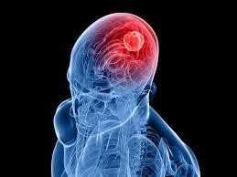
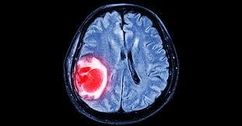
Brain tumor occurs because of anomalous development of cells. Millions of deaths can be prevented through early detection of brain tumor. Tumours can start in the brain, or elsewhere in the body can spread to the brain.
Symptoms include new or increasingly strong headaches, blurred vision, loss of balance, confusion and seizures. In some cases, there may be no symptoms.
According to the American Brain Tumor Association, about 80,000 men, women, and children were expected to be diagnosed with a primary brain tumor during 2017.

Slide 5
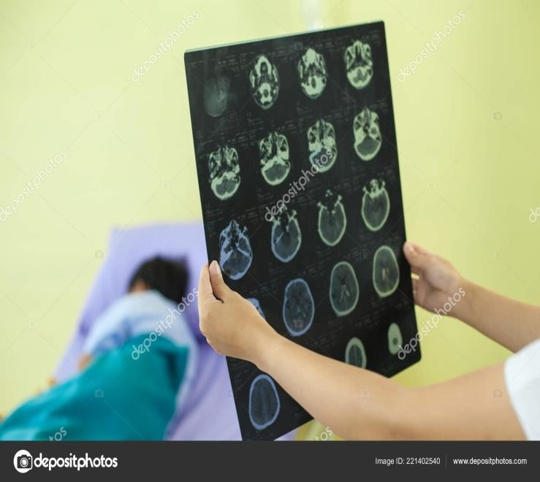


In the present scenario, the radiologists have to manually study the tumors with the available medical imaging tools and generate a report. The process is time consuming.
The task becomes
near impossible when we’re faced
with a massive number of images, say 10,000 or even 100,000.

Slide 6
PROBLEM STATEMENT
The point of the step is tumor identification in brain MRI images.
we design a system to correctly classify new brain Ultrasound images into images with tumor and images without tumor.– reframe the statement

Slide 7
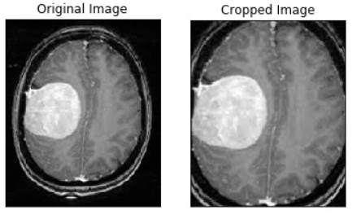
IMAGE PREPROCESSING
Our image consists of black region as background, we want to remove this background and grab only the top, bottom, left and right side of brain. For this, we will convert the image to grayscale and use guassian blurring to blur the image and apply thresholding to remove any noisy points and grab the largest contor to find the extreme points(Left, right, top, bottom) and crop the brain image

Slide 8
Literature survey:
S .No | Title of the paper with year | Techniques | Drawbacks
1. | Deep Learning-Based Deformable Image Registration of Infant Brain MR Images with Tissue Segmentation Chen Qin, Tianyuan Zhang, Yi Zhang, Ling Zhang, and Guoliang Fan ,published in IEEE transactions on medical imaging ,may 2021 . | The method uses a convolutional neural network (CNN) This paper proposes a deep learning-based deformable image registration (DIR) method | Requires large amount of training data to learn to perform well. It can be computationally expensive with an accuracy of 81 percentage.
2. | Infant Brain MRI Registration Using a Spatially-Adaptive Deep Learning Model published in IEEE transactions on medical imaging by qin et al (2022). | The model uses a CNN to extract features from the images, and then a deformable registration network (DRN) to estimate the deformation field | It can be computationally expensive with an accuracy of 83 percentage It depends on the quality of tissue Segmentation.
3. | Recurrently Usable Deep Neural Network for the Registration of Infant Brain MR Images by Chen et al at IEEE transcations in 2022. | This paper is a precursor to the RTA-Net paper. It proposes a recurrently usable deep neural network for the registration of infant brain MRI images. | It may not be suitable for all types of infant brain MRI images. Can be computationally expensive with an accuracy of 87 percentage.
4. | Learning-Based Deformable Image Registration for Infant Brain MRI by Integrating Random Forest with Auto-Context Model by quin et al in IEEE transactions at 2017. | This paper proposes a learning-based deformable image registration (DIR) method for infant brain MRI images by integrating random forest with an auto-context model | It is explicitly suitable for particular type of infant brain MRI images. Requires large amount of data with an accuracy of 85 percentage
5. | Deep Learning-Based Deformable Image Registration for Infant Brain MRI Using Cascaded Networks by Chen Qin Yi chang in IEEE transactions in 2022 | The method uses a two-stage cascaded network architecture.The first stage network is trained to estimate a coarse deformation field | Training large amount of data is difficult and time consuming Can be computationally expensive With an accuracy 89 percentage.

Slide 9
EXISTING SYSTEM
Malignant brain tumors are one of the leading causes of death in adults and children.
To identify a brain tumor, an MRI image is acquired and analyzed manually by an expert to find lesions.
In Existing system, present two methods for the detection of brain tumors in medical images.
The first is based on Deep Learning through the U-net architecture that has proven its robustness vis-à-vis the segmentation of images, especially medical images.

Slide 10
DISADVANTAGES
In the existing Detection approaches, the multiresolution fusion approaches have been widely used in the recent studies because of their poor efficiency and inconvenience and their fusion results are usually limited by the number of decomposition layer and the selection of fusion rules.
Also distort the spectral characteristics with different degree.
A detailed study indicated that the color distortion problem arises from the change of the saturation during the fusion process.

Slide 11
PROPOSED SYSTEM
Deep learning (DL) enables a pre-trained Convolutional Neural Network (CNN) model for medical images. CNN-based classifier systems are fully automated and do not require manually segmented tumor regions. Some researchers have proposed different CNN architectures. Most of the CNN models reported multiclass brain tumor detection. We have developed a hybrid model based on CNN for classifying the tumor type in the brain.
We have proposed an automated brain tumor detection mechanism applying CNN with transfer learning models on the Ultrasound brain image dataset

Slide 12

Brain Ultrasound images
Image Processing
Image dataset
Training
data
Testing
data
Learning
algorithm
Classification
model
Image input
Predicted output

Slide 13
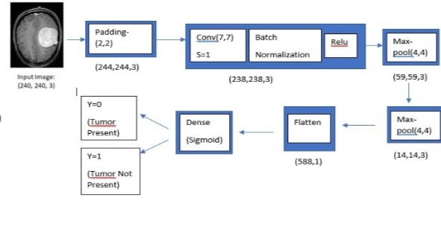
MODIFIED CNN-ARCHITECTURE

Slide 14
DATA AUGMENTATION
The dataset contains 2 classes: yes and no which contains 253 Brain MRI Images. The class yes contains 155 Brain MRI Images that are tumorous and the class no contains 98 Brain MRI Images that are non-tumorous. Since this is a small dataset, we can use data augmentation in order to create more images.
We can also get rid of imbalanced data as 61% of previous data contains yes hence data augmentation will also solve this problem

Slide 15
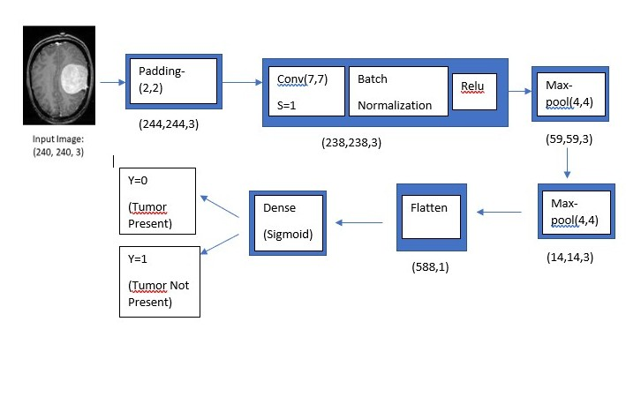
CNN-ARCHITECTURE-1 CONV(7,7)

Slide 16
CNN-ARCHITECTURE -1
Each input x (image) has a shape of (240, 240, 3) and is fed into the neural network. And, it goes through the following layers:
A Zero Padding layer with a pool size of (2, 2).
A convolutional layer with 32 filters, with a filter size of (7, 7) and a stride equal to 1. A batch normalization layer to normalize pixel values to speed up computation.
A ReLU activation layer.
A Max Pooling layer with f=4 and s=4.
A Max Pooling layer with f=4 and s=4, same as before.
A flatten layer in order to flatten the 3-dimensional matrix into a one-dimensional vector.
A Dense (output unit) fully connected layer with one neuron with a sigmoid activation (since this is a binary classification task).

Slide 17
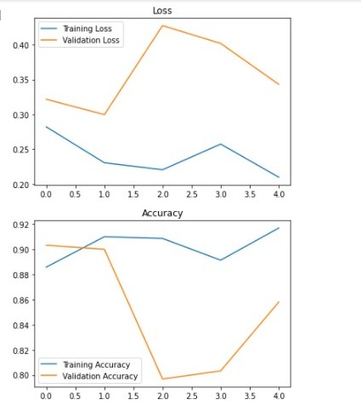
ACCURACY-CONV(7,7)
After running through multiple epochs ,
As we can see through multiple epochs training loss and validation loss decreases.
Training accuracy of the model is quite high 98.3% while the validation accuracy is 98%
Accuracy on test data is 97%.

Slide 18
Modules of the project:
Data collection and preprocessing
Develop network architecture
Network training
Network evaluation
Results and Conclusion

Slide 19
Algorithm:
First MRI and Ultra Sounds has been chosen and resized to equal.
Object of interest on MRI is obtained through region mapping and low and high frequency components are separated through filtering.
Next, the Ultra Sound is transformed into IHS and low and high frequency separation is obtained through HUE angle.
Apply the Dual Tree Framelet Transform on both images to transform from spatial to frequency domain.
Perform averaging over frequency components to fuse the images.
Apply Inverse Framelet Transform again to convert form frequency to spatial domain.
Adjust the structural information in the gray matter (GM) area and then patching the spectral information in the white matter (WM) area.
Inverse IHS Transform is applied to convert fused model into original color model.

Slide 20
ADVAN TAGES:
The proposed image fusion has several advantages in the field of digital image processing.
The useful information can be gathered into a single image from multiple images which reduce the time complexity of processing.
The image fusion improves the reliability of the resultant image by grouping the redundant information into a single image.
The capability of the image can be improved by having the complementary information in the fused image.

Slide 21
Hardware and Software Specification
HARDWARE REQUIREMENTS:
System : Pentium IV 2.4 GHz.
Hard Disk : 40 GB.
Floppy Drive : 44 Mb.
Monitor : 15 VGA Color.
Mouse :
Ram : 512 Mb.
MOBILE : ANDROID
SOFTWARE REQUIREMENTS:
Operating system : Windows 7.
Coding Language : Python
IDE : Anaconda Ide

Slide 22
FURTHER IMPROVEMENTS
To implement various other Neural network Architecture like AlexNet, ResNet
,VGG-16,19 and transfer learning and compare their accuracy to get the best model for classification of MRI Brain Images.

Slide 23
CONCLUTION
In this project, we propose a new fusion method for fusing Ultrasound and MR Tumor images based on Framelet Transform with structural information adjustment and spectral information patching.
Our method is different from the regular simple Framelet Transform fusion method in that our method performs Frames decomposition with different levels for low- and high-activity regions, respectively, in the Ultrasound and MR Tumor images.
In addition we did image segmentation algorithm for detection of Fetal Tumor with proposed fusion images.

Slide 24
REFERENCES
•
•
•
A Machine Learning Technique for MRI Brain Images
MRI Brain Image Segmentation using Machine Learning Techniques
A Survey On Brain Tumor Detection Based On Structural MRI Using Machine Learning And Deep Learning Techniques
A Review on MRI Brain Image Segmentation Techniques Multi stage classification and segmentation of brain tumor
A Hybrid Feature Extraction Method With Regularized Extreme Learning Machine for Brain Tumor Classification A Survey on Advanced Segmentation Techniques for Brain MRI Image Segmentation
Deep learning based brain tumor classification using magnetic resonance imaging An overview of deeplearning in medical imaging focusing on MRI
Brain Tumor Detection Using Deep Neural Network and Machine Learning Algorithm
Detection Of Tumour Using Grey Level Co-Occurrence Matrix And Lifting Based DWT With Radial Basis Function
•
•
•
•
•
•
•
•
•

Slide 25
THANK YOU

